Slide 1
18CSC304J– COMPILER DESIGN
PROJECT PRESENTATION
COMMAND LINE CALCULATOR

Slide 2
COMMAND LINE CALCULATOR
PRESENTED BY-
PREM KUMAR (RA2011033010057)
RIMENDRA KUMAR AGRAWAL (RA2011033010064)

Slide 3
INDEX
OBJECTIVE AND SCOPE
ABSTRACT
INTRODUCTION
HARDWARE/SOFTWARE REQUIREMENTS
ALGORITHM
ARCHITECTURE DESIGN/BLOCK DIAGRAM
SOURCE CODE
RESULT/OUTPUT
CONCLUSION
REFERENCES

Slide 4
OBJECTIVE AND SCOPE
The objective of a command line calculator project is to create a program that allows users to perform arithmetic and mathematical operations via the command line interface. The scope of the project can vary depending on the specific requirements and goals, but it may include features such as:
Accepting user input for mathematical expressions, including basic arithmetic operations (+, -, *, /), parentheses, and functions (e.g., sin, cos, sqrt).
Evaluating the input expression and producing the corresponding output.
Handling errors such as invalid input or division by zero.
Allowing the user to store and recall previous calculations.
Providing additional features such as support for complex numbers, units conversion, or plotting graphs.
The project can be implemented in various programming languages, including Python, C++, or Java. It may involve parsing input strings, implementing algorithms for arithmetic operations, and designing a user-friendly interface. Overall, the goal is to create a reliable and efficient calculator program that can be used via the command line interface.

Slide 5
ABSTRACT
A command line calculator which supports mathematical expressions with scientific functions is very useful for most developers. The calculator available with Windows does not support most scientific functions. Most of the time, I do not feel comfortable with the calculator available with Windows. I needed a calculator which will not restrict writing expressions. I use variables to store results. Every time I need a simple calculation, I have to face problems with the Windows calculator. To make such a calculator, I designed a complete Mathematics library with MFC. The most difficult part I found when designing such a calculator was the parsing logic. Later while working with .NET, the runtime source code compilation made the parsing logic easy and interesting. I read some articles on .NET CodeDOM compilation. And I decided to write a new command line calculator using CodeDOM. It uses runtime compilation and saves the variables by serializing in a file. Thus you can get the values of all the variables used in the previous calculation.

Slide 6
INTRODUCTION
In this command line calculator, the result is saved in a pre-defined variable called ans. The user can declare his/her own variables to store results and can use it later in different expressions. The validation of the variable name is the same as in C#. Similarly, expression support is the same as supported in C# .NET.The calculate function calculates an expression. It uses the saved variables. I have generated code which has a declaration of the variables.To Evaluate the given expressions.To perform basic calculations.

Slide 7
HARDWARE/SOFTWARE REQUIREMENT
Software Requirements:
C compiler (gcc, cc, egcs,..)
Hardware Requirements:
CPU : Intel Core i5
Memory : 8GB for RAM

Slide 8
ALGORITHM
Step 1 — START
Step 2 — input
Step 3 — parse_expr()
Step 3.1 parse_term()
Step 3.1.1 parse_factor()
Step 3.2 parse_num_op()
Step 3.2.1 parse_rest_term()
Step 3.3 parse_factor()
Step 3.3.1 parse_num_op()
Step 3.4 parse_rest_term()
Step 3.4.1 parse_rest_expr()
Step 4 — STOP

Slide 9
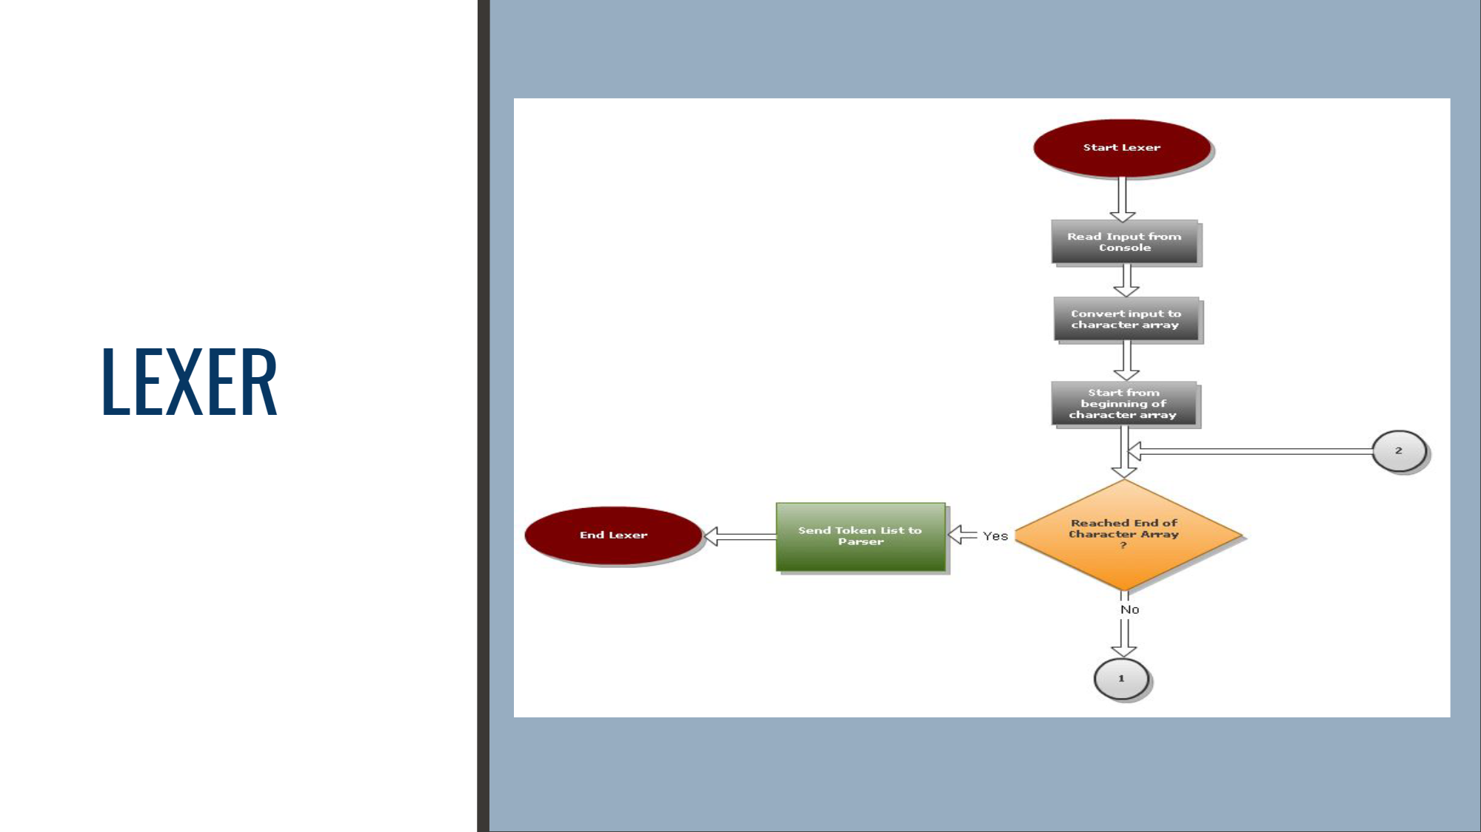
ARCHITECTURE DESIGN IMPLEMENTATION

Slide 10
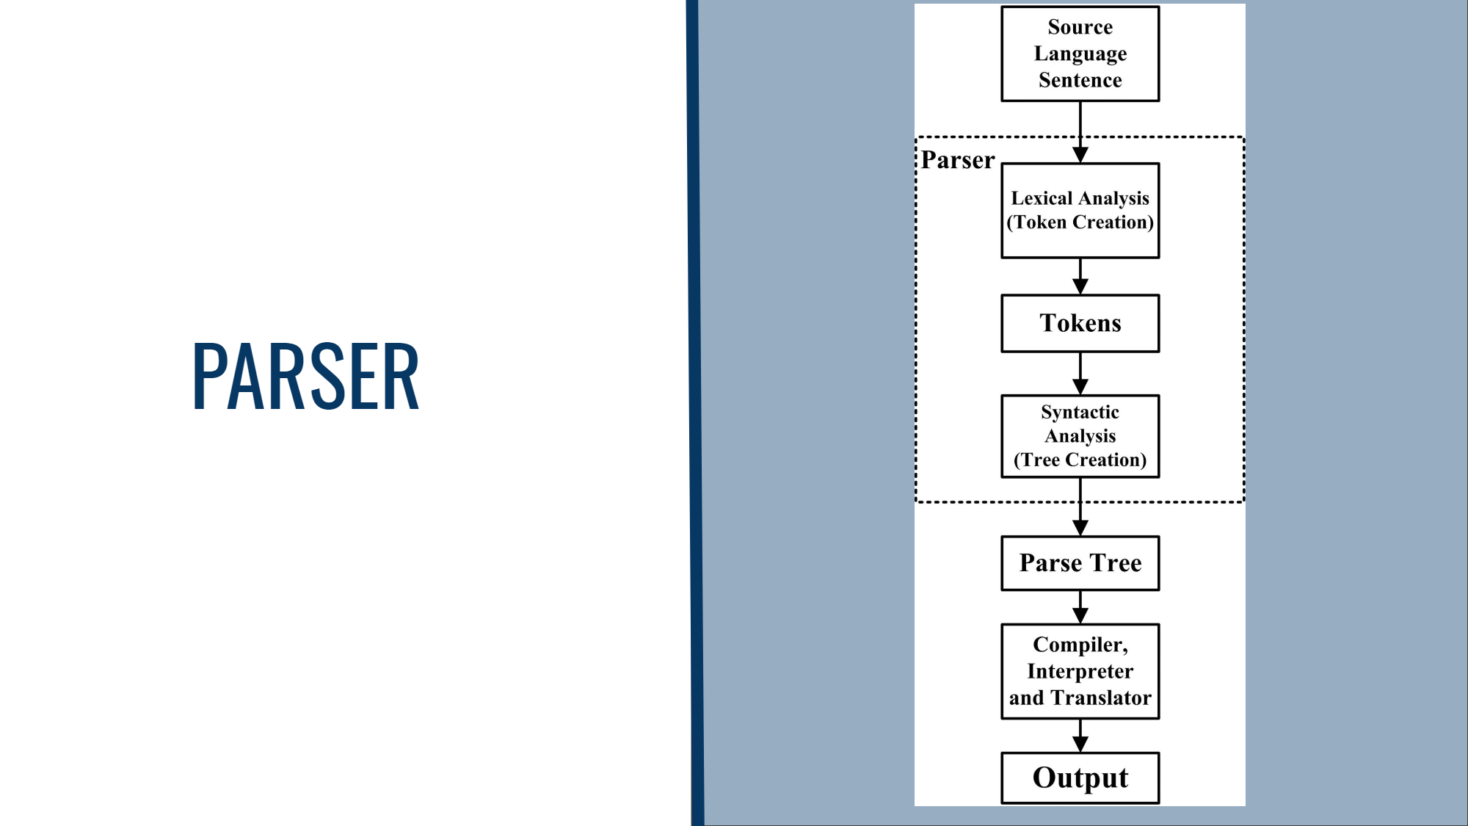

Slide 11
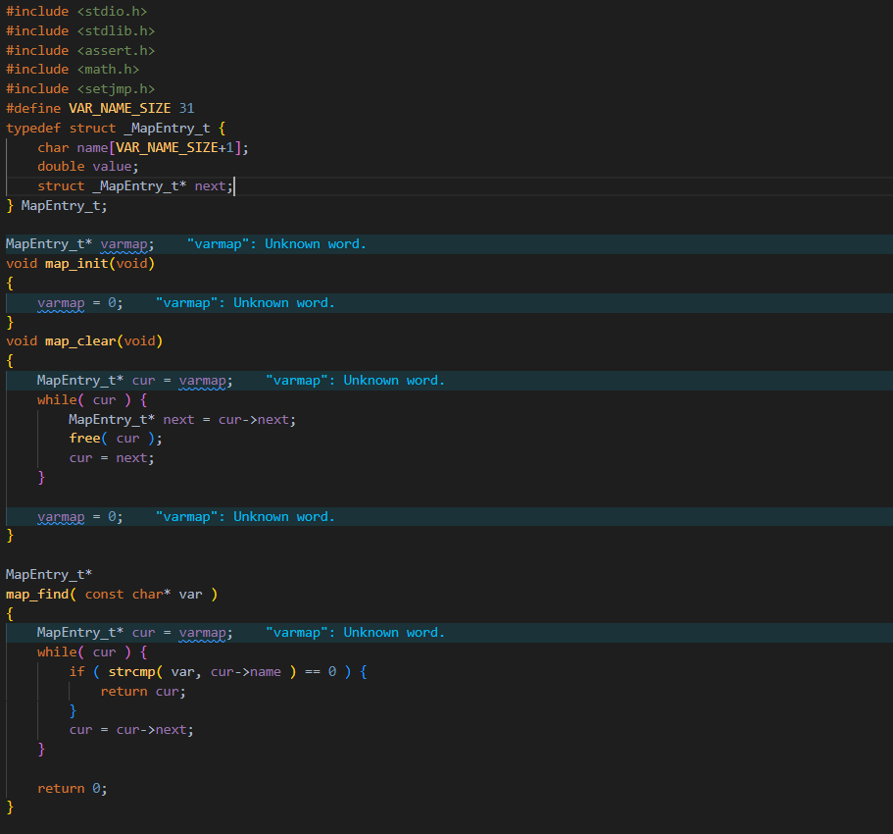
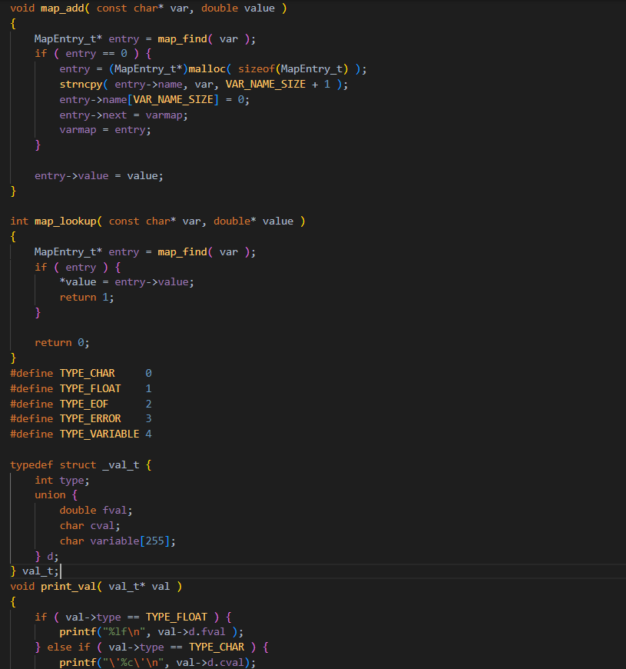
SOURCE CODE

Slide 12
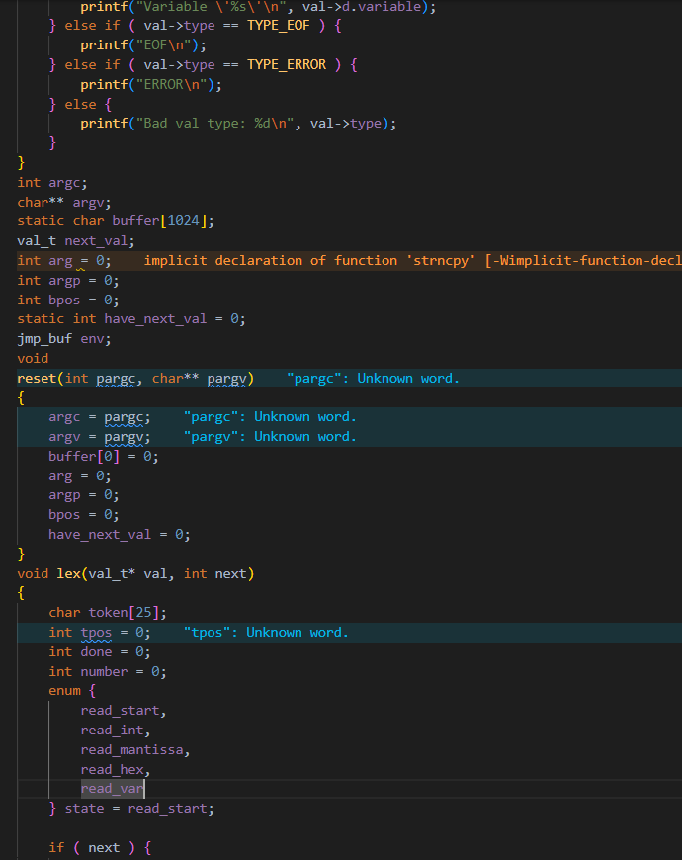
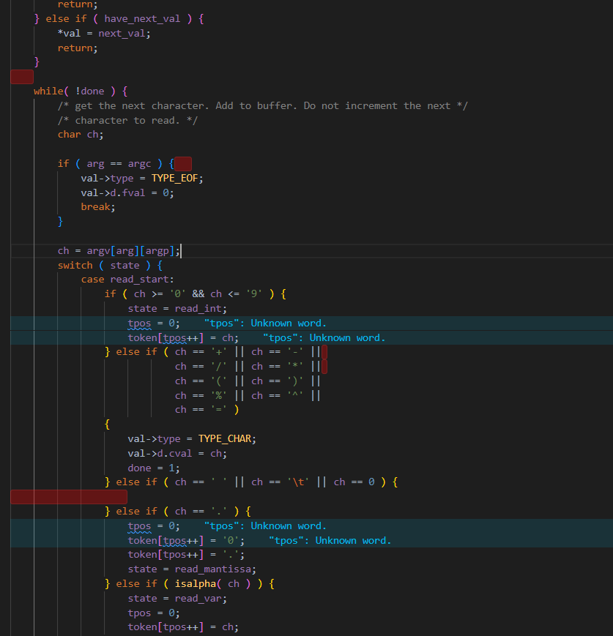

Slide 13
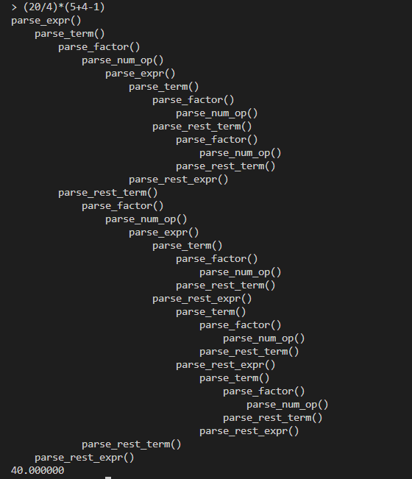
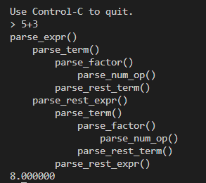
RESULT/OUTPUT

Slide 14
CONCLUSION
This is a powerful and versatile command-line calculator that really lives up to your expectation. Preloaded on all modern Linux distributions, this can make your number crunching tasks much easier to handle without leaving your terminals. Besides, if your shell script requires floating point calculation, can easily be invoked by the script to get the job done. All in all, CLC should definitely be in your productivity tool set.

Slide 15
REFERENCES
[1] — https://www.codeproject.com/Articles/12395/A-Command-Line-Calculator
[2] — https://fedoramagazine.org/bc-command-line-calculator/

